Slide 1




DIBBs Brown Dog Adding Extractors

Slide 2
How to Write an Extractor
To make writing of an extractor easy, an extractors-template has been provided here: https://opensource.ncsa.illinois.edu/bitbucket/projects/BD/repos/extractors-template/
In the tutorial VM, it has been downloaded for you in the directory, /home/ubuntu/git/extractors-template
To run the extractors-template, you need to make sure MongoDB, Clowder and RabbitMQ are running.
Go into the /home/ubuntu/git/extractors-template directory, you will see several files.

Slide 3
PyClowder
A Python library that wraps Clowder API and provide them as methods
Provide easy way to connect to RabbitMQ.
The pyClowder library can be found in
https://opensource.ncsa.illinois.edu/bitbucket/projects/CATS/repos/pyclowder/browse
It has been installed in the VM so you can use it

Slide 4
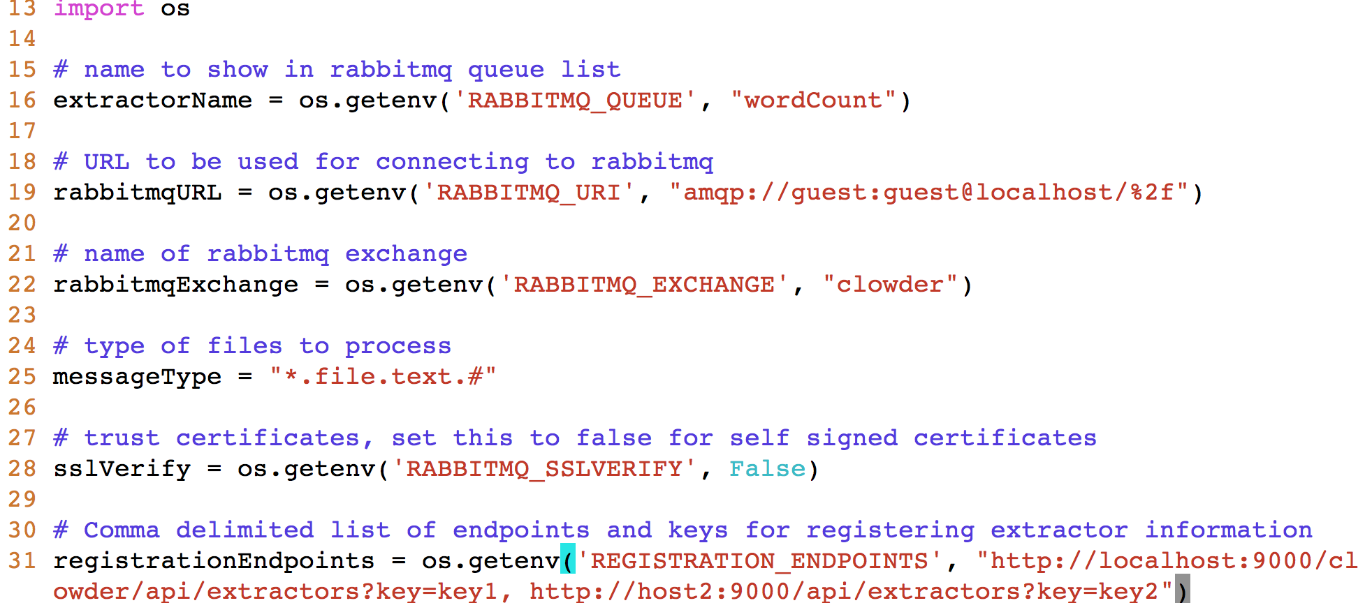
config.py
All default values have been set
Modify the ‘REGISTRATION_ENDPOINTS’ parameter value to http://127.0.0.1:9000/api/extractors?key=r1ek3rs

Slide 5
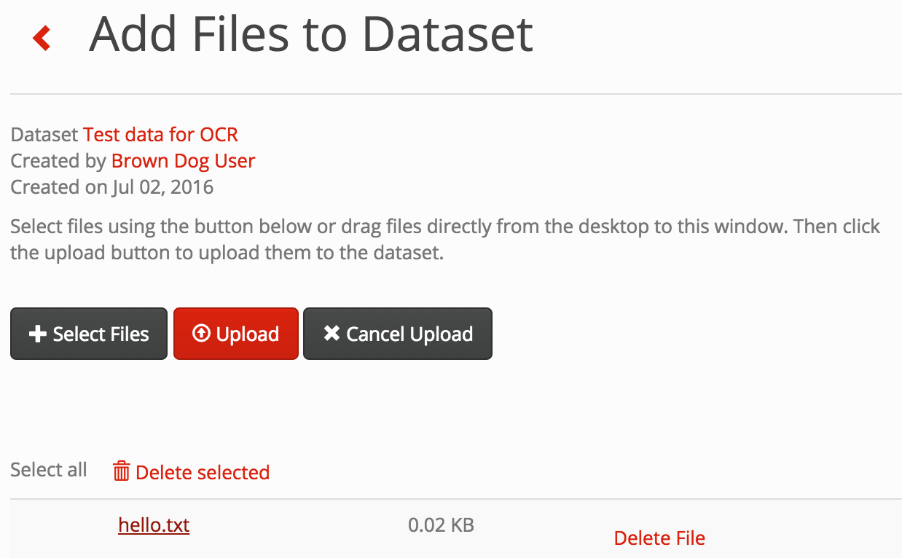
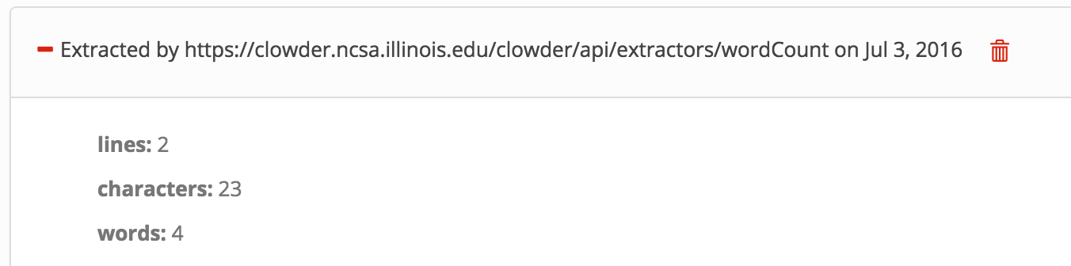
Lets run the template extractor
Run the extractor
./extractor.py
Go to Clowder, create a dataset, upload a text file to the dataset
Click on the text file uploaded, you will see metadata extracted – lines, character, words

Slide 6
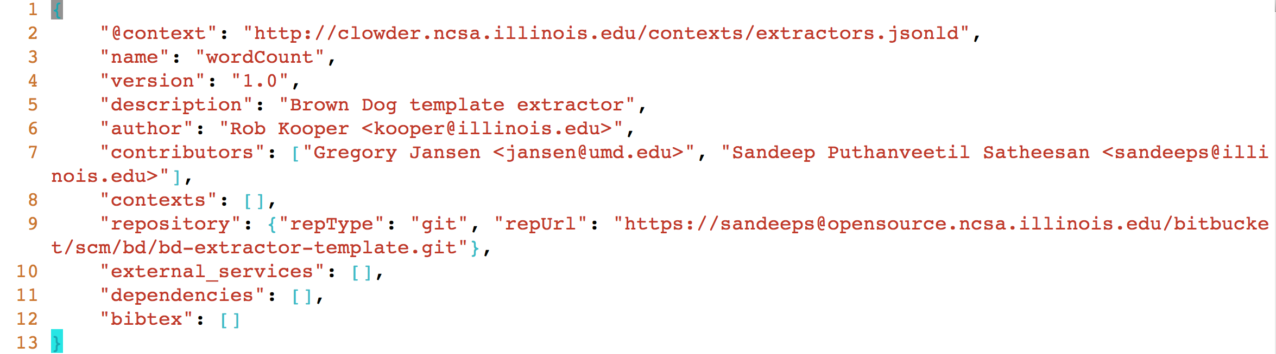
extractor_info.json
This file is posted to the Clowder to register itself with Clowder.

Slide 7
extractor.py
main() – No Change Required
Registers the extractor’s info to different Clowder instances
http://141.142.X.X:9000/api/extractors - to see extractors info
Sets up all parameters
Connects to RabbitMQ
process_file(parameter) -- Needs to be implemented by you.
Extraction of metadata
Example – Wordcount from a text document

Slide 8
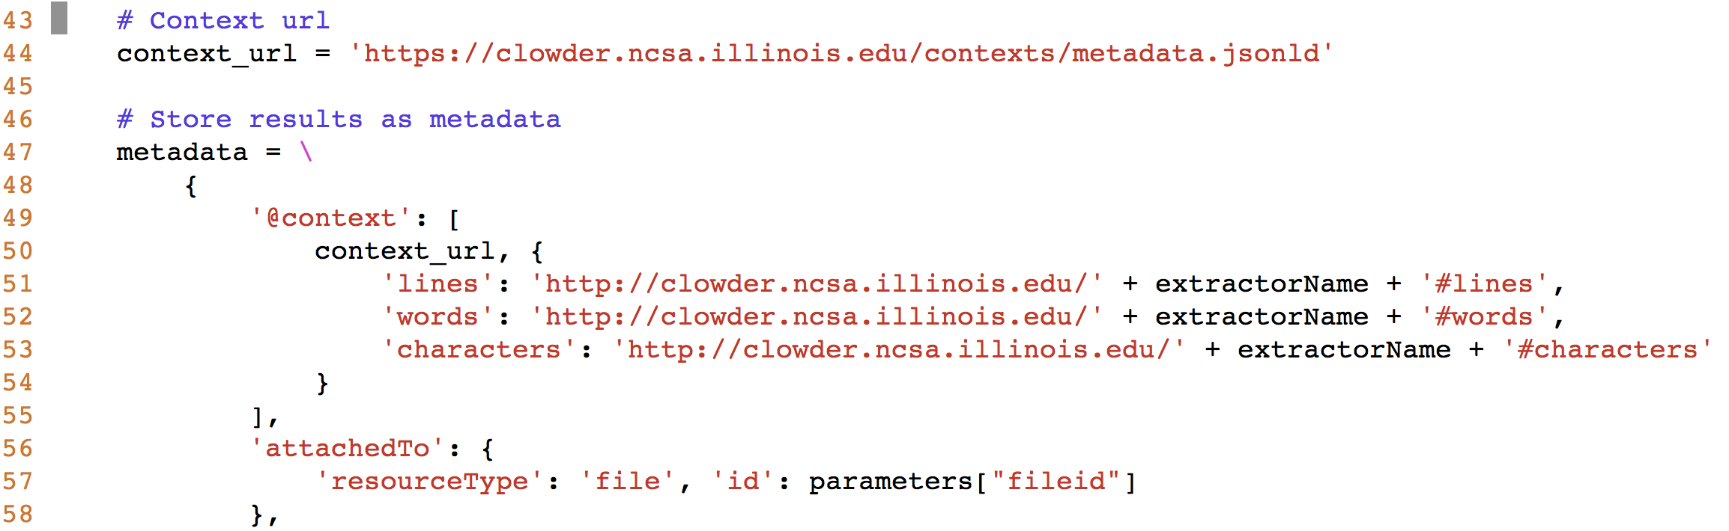
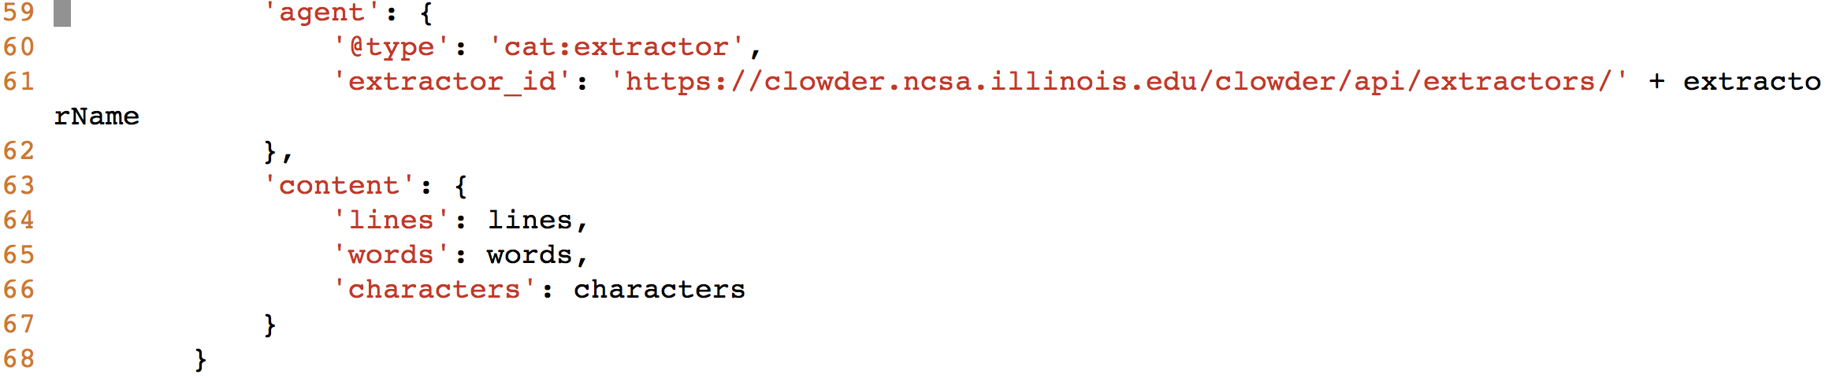
extractor.py
Add context to the metadata and stores metadata extracted in jsonld format

Slide 9
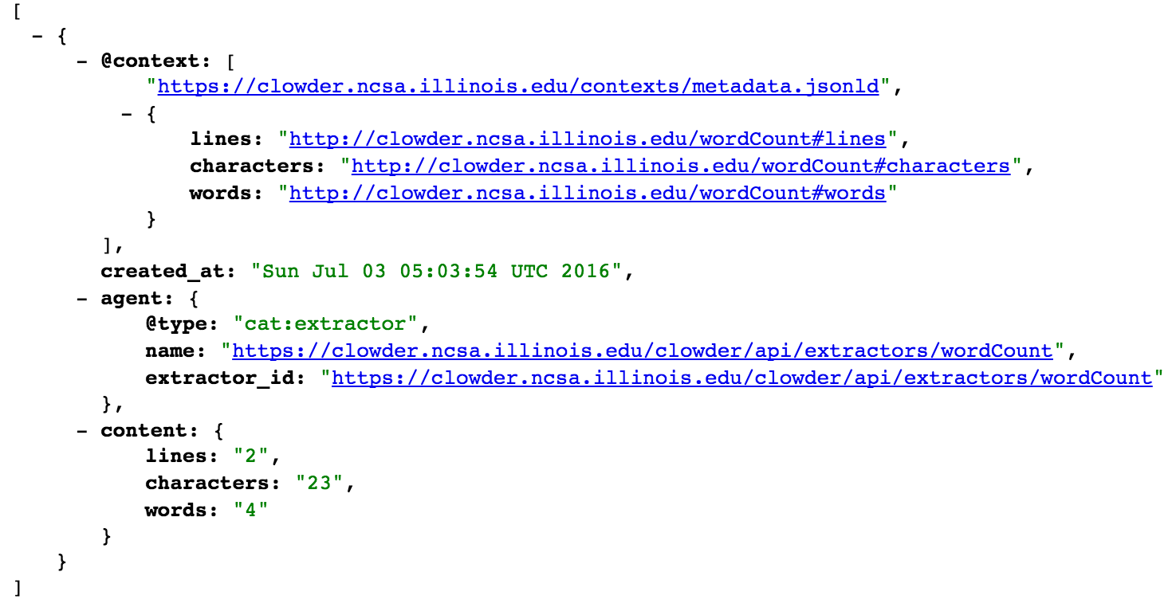
Metadata in JSON-LD format
http://141.142.208.169:9000/api/files/<fileid>/metadata.jsonld

Slide 10
JSON-LD (http://json-ld.org/)
A JSON-based format to serialize Linked Data
Every value stored in the document is universally identified using a URI
JSON-LD is a concrete RDF syntax, one could start by reading about RDF.
But JSON-LD can also be thought of as a way of taking an existing JSON document and annotating with a @context that defines every key in the JSON document.
References:
https://en.wikipedia.org/wiki/Linked_data
2. https://www.w3.org/RDF/

Slide 11
Upload the metadata to Clowder in jsonld format
Lets build another extractor …

Slide 12
grep extractor
The extractor should be able extract wordcount and also try to find if a specific word is there in the text
Copy the template folder to another new folder where we would like to create a new extractor
mkdir extractor_grep
cd extractors-template
cp *.* ../extractor-grep/
Change ExtractorName value to ncsa.grep in the config.py
Change ‘name’ in extractor_info.json to ncsa.grep, and necessary fields information

Slide 13
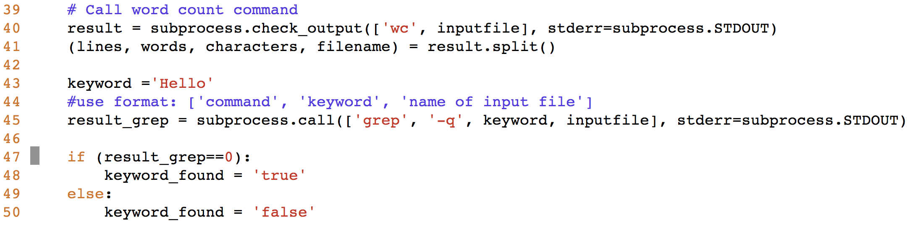
Add these lines to the process_file (extractor.py) after wordcount extraction

Slide 14
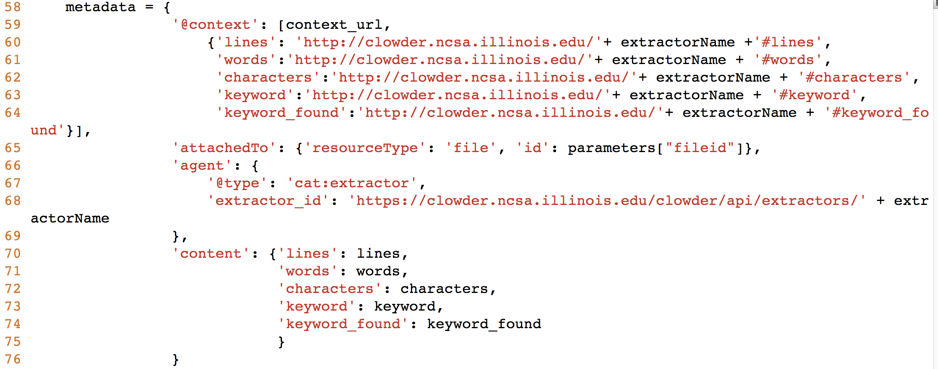
Add context and prepare metadata in the json_ld format

Slide 15
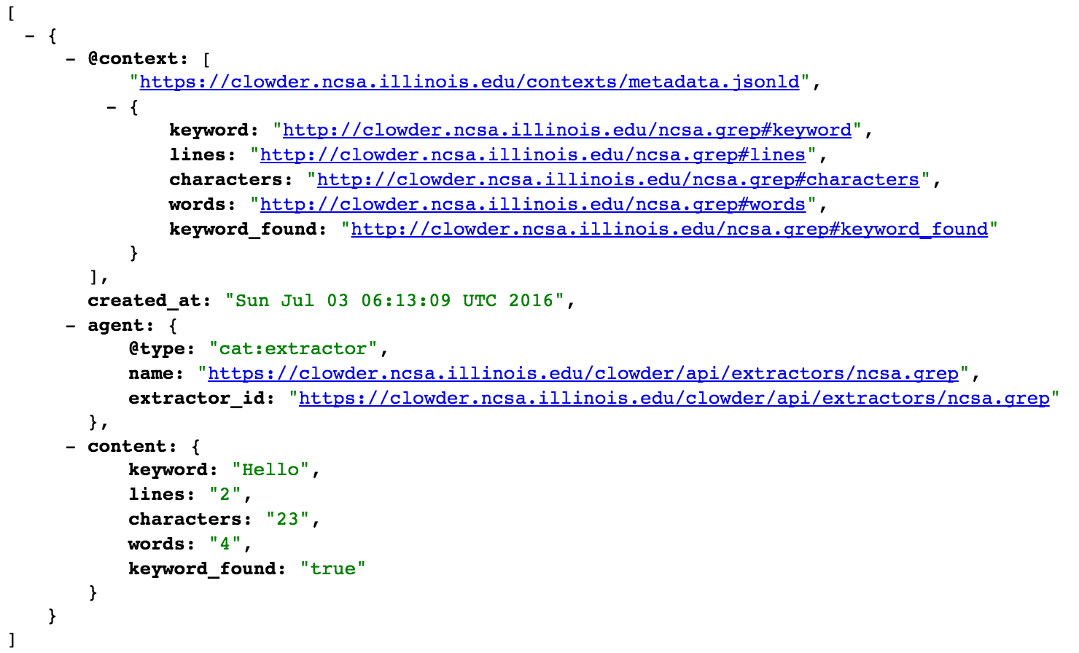
Upload metadata in jsonld format to the clowder as in wordcount example.

Slide 16
Lets try out another example
Given a CSV file with weather data, calculate statistics such as mean and standard deviation for temperature specified in a column
Like in the previous example, copy the extractor-template folder to extractor-csvstats
Modify extractorName value in config.py to "*.file.text.csv", "extractors." + extractorName
Modify extractor_info.json with new extractor information

Slide 17
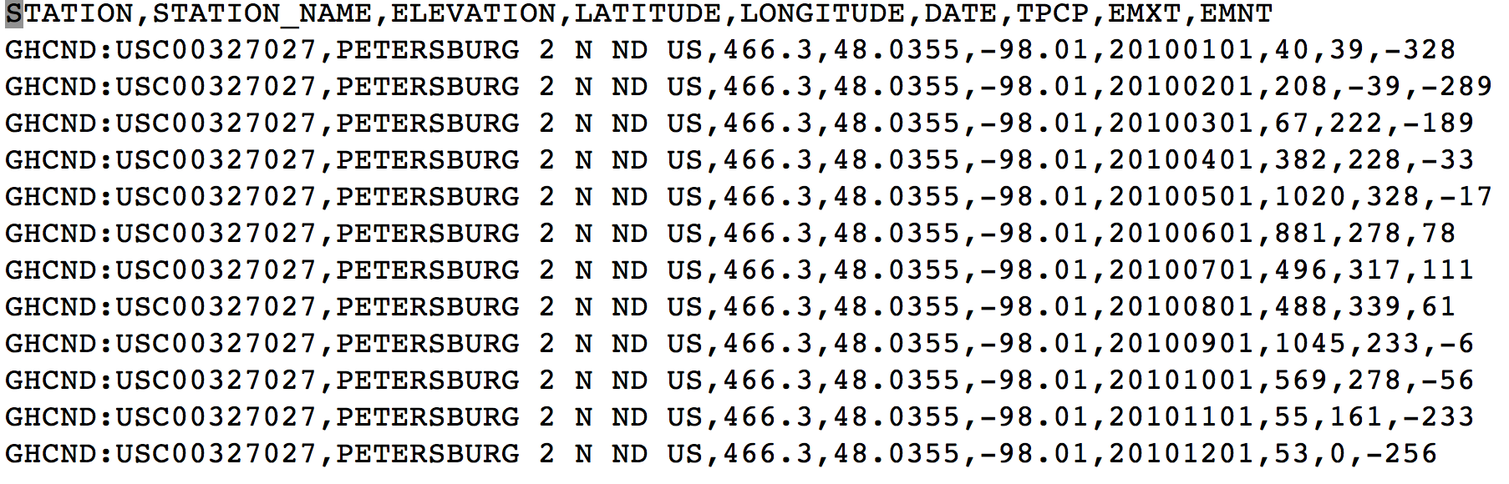
Input file (input.csv)
Weather data collected -9 Columns – Details (TODO)

Slide 18
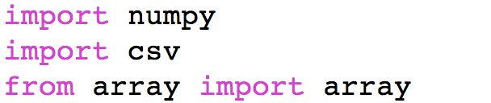
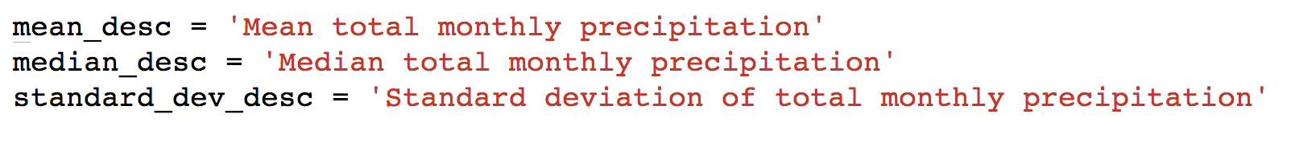
extractor.py
Import required modules and remove modules not required for this extractor, e.g. subprocess
Start implementing process_file(parameters)
Initialize statistics description

Slide 19
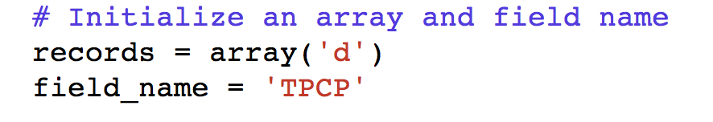
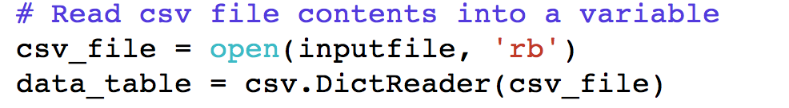
extractor.py
Initialize an array and field name on which statistics would be calculated
Read the input csv file contents
Obtain ‘TPCP’ value for each row and append to records variable

Slide 20
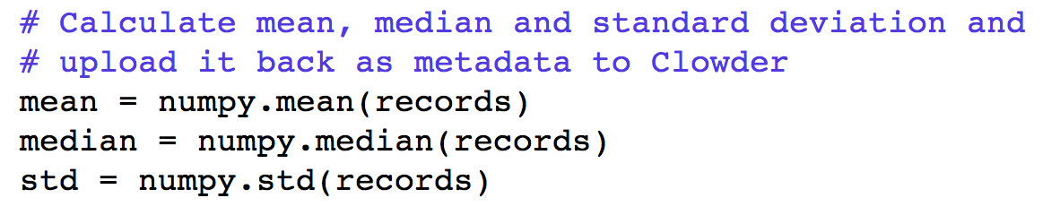
Calculate the statistics
Keep the context_url the same

Slide 21
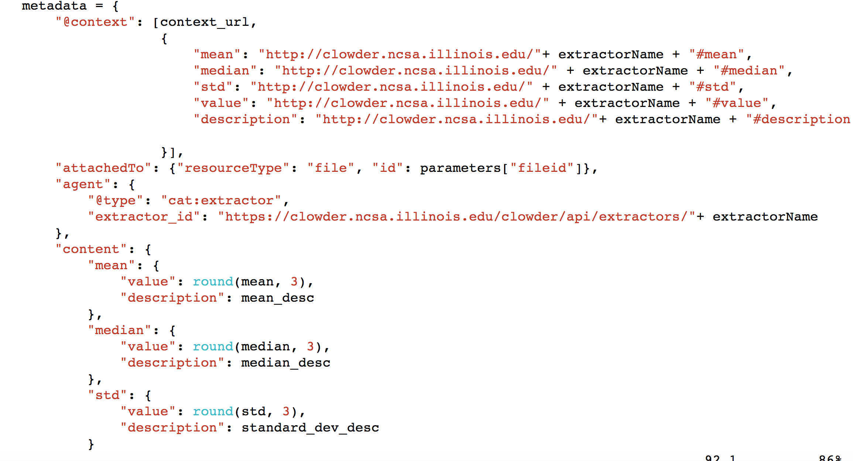
Prepare metadata to be uploaded to the Clowder

Slide 22
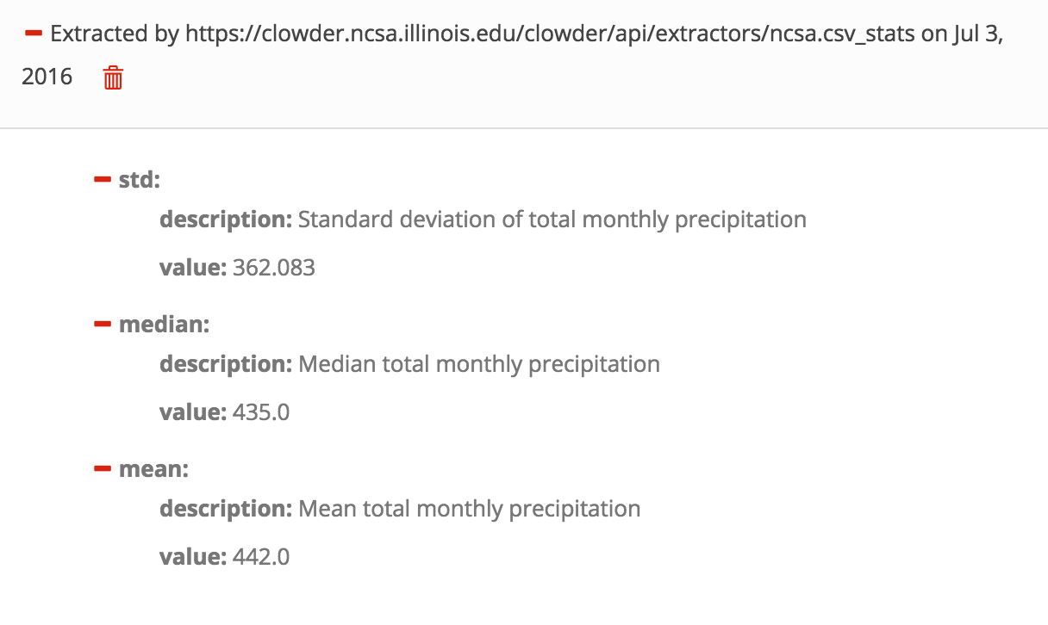
Metadata in the Clowder Interface

Slide 23
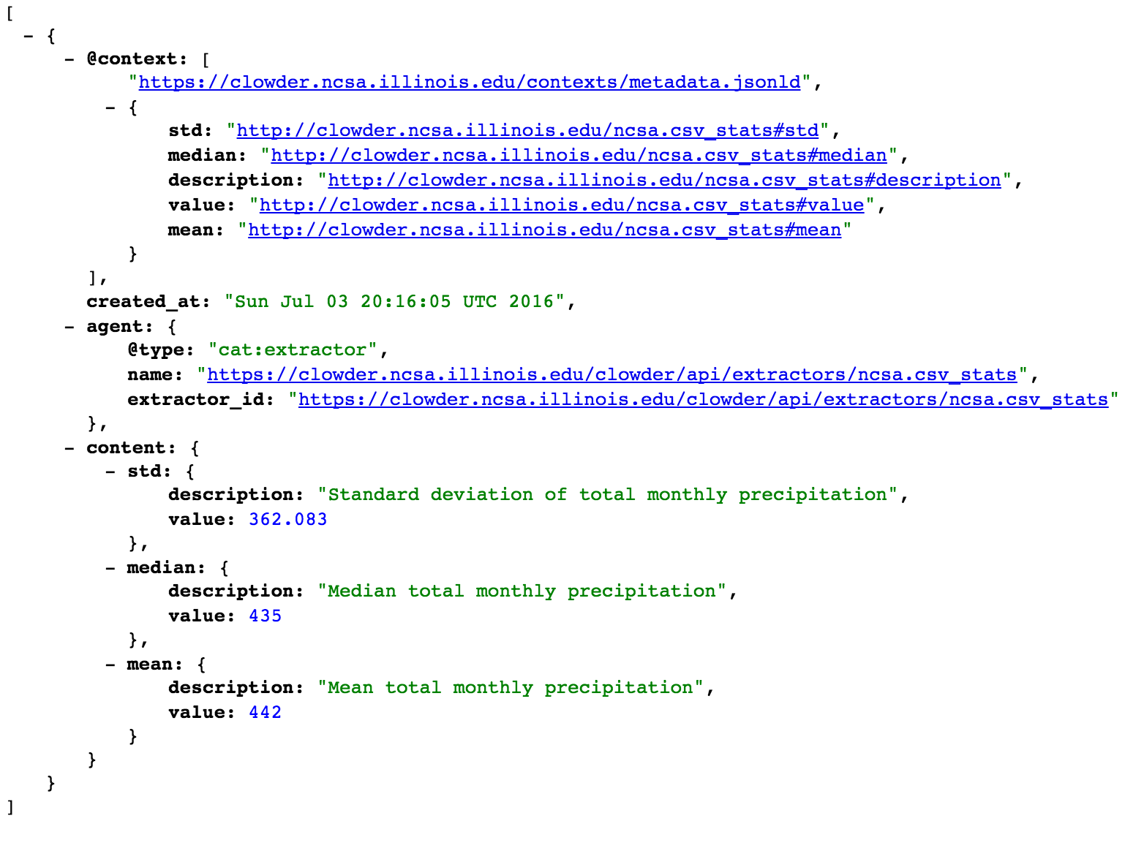
Metadata in jsonld format

